Slide 1
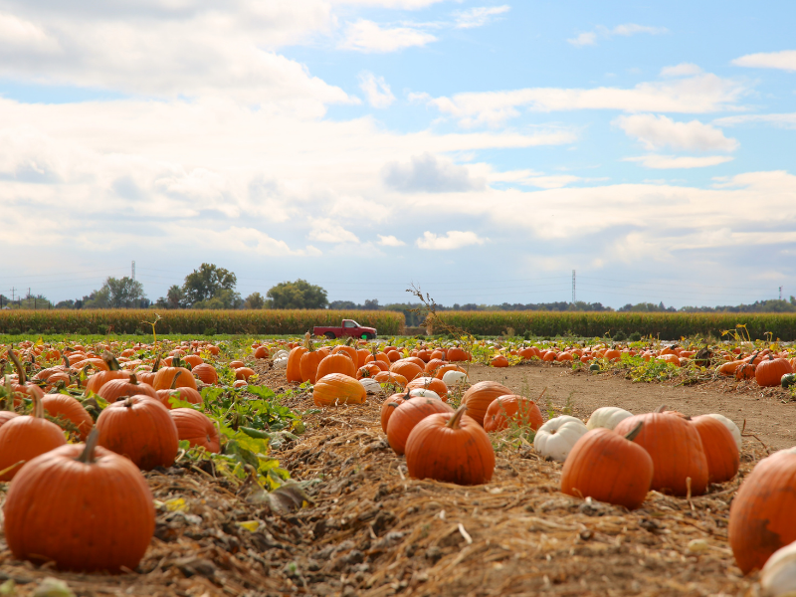
Conservation and Pumpkins Stations
Packet includes teacher instructions,
station materials, student answer sheet,
and teacher answer sheet key.
Photo credit: Canva Pro

Slide 2
Teacher Instructions – Classroom Set-up
This station lesson works best if students can move throughout the room and utilize printed copies of station instructions with additional materials.
Print station materials (in this file) in the packet, cut cards, laminate materials (if desired), and collect all printed and supplemental materials (included in station set-up and material list) for each station. Please note that depending on the number of students and classroom size, two or three of each station set up may be necessary. Set up at least one of each six stations around the room with all necessary materials.
Print student answer sheets for the class and a teacher answer sheet key for your use.
During class, hand out student answer sheets, give directions to class of how and when they are to rotate to different stations, and divide students into small groups.
Teacher Instructions – Grading Recommendation
These stations are intended to be a student-led learning activity at the beginning of a unit. If you are grading stations, it is recommended that you consider giving points for 1) station engagement or participation 2) correct answers at certain stations such as Video, Reading, Vocabulary.
Additional Station Tips
Keep student groups to 3-4 students per group.
Give students 7-10 minutes at each station.
Set a projected or visible timer so students know how much time they have at each station and when to move to the next station.
Continue circulating throughout the room during stations to be available for questions or checking answers.

Slide 3
Teacher Instructions – Station Set-up & Material List
Day 1 Stations
These stations introduce topics and students will begin learning about pumpkins and associated conservation practices.
Video
Place a device (laptop, iPad, etc.) at the station. The video for this station is on YouTube. Students will watch the video and answer the related questions.
Full URL: https://youtu.be/8EwxlrJ_dZ4?si=GxfbQ4CN-j6hmNZ5
Reading
Print 2-3 copies of the article so students can read independently at the station. The article can be found on the Crop Science Society of America website. Students will read the article and answer the related questions.
Full URL: https://www.crops.org/news/science-news/pumpkin-production-can-benefit-conservation-practices/
Vocabulary
Place 1 or 2 sets of word and definition cards (included in this file) at this station. Students will pair the word with the correct definition and check with you for correctness.
Day 2 Stations
It will be helpful for students to have notes and introductory information from Day 1 stations before completing these stations.
Model
Place a device (laptop, iPad, etc.) at the station. Key information for this station is found in the printed graphic (in this file) and a time-lapse video on YouTube. Students will review the materials and draw an accurate model of a pumpkin plant.
Full URL: https://youtu.be/yHaPDJCLCqM?si=yiWMKvePoUdgsqDU
Comparison
Place a device (laptop, iPad, etc.) at the station. The video for this station is on YouTube. Students will watch the video and draw on knowledge from the previous day of stations to answer related questions.
Full URL: https://youtu.be/K58bCncnNMQ?si=z3eghnTjelu1Ofn-
Review
No additional materials beyond station information (in this file) are needed. Students will draw on knowledge from previous stations to answer the prompt.

Slide 4
Teacher Instructions - Stations Roadmap
Station(s) | Learning Objective | Related AFNR Standard(s)
Video & Reading | Students will be able to list at least two conservation practices utilized on pumpkin operations that can improve soil health, water quality, wildlife habitat, etc. | AFNR PS.03.04. Apply principles and practices of sustainable agriculture to plant production.
Vocabulary, Model, Comparison | Students will be able to recall at least three components and functions of pumpkin plants’ flowers. | AFNR PS.02.02.05.a Identify and summarize the components of a flower, the functions of a flower, and the functions of flower components.
Review | Students will be able to describe the role of pollinators in pumpkin growth and production (when considering pumpkin flower structure and function) and the connection to conservation practices. | AFNR NRS.02.05 Communicate information to the public regarding topics related to the management, protection, enhancement, and improvement of natural resources.

Slide 5
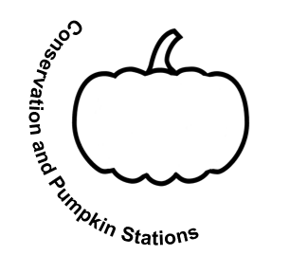
Video Station - Instructions
Each student in the group will watch the video, Habitat Tip: Pumpkins, Pollinators, and Great Habitat video by Conservation Blueprint, and answer the questions from the cards on the answer sheet in the “Video” section.
Video Station
- Day 1 -

Slide 6
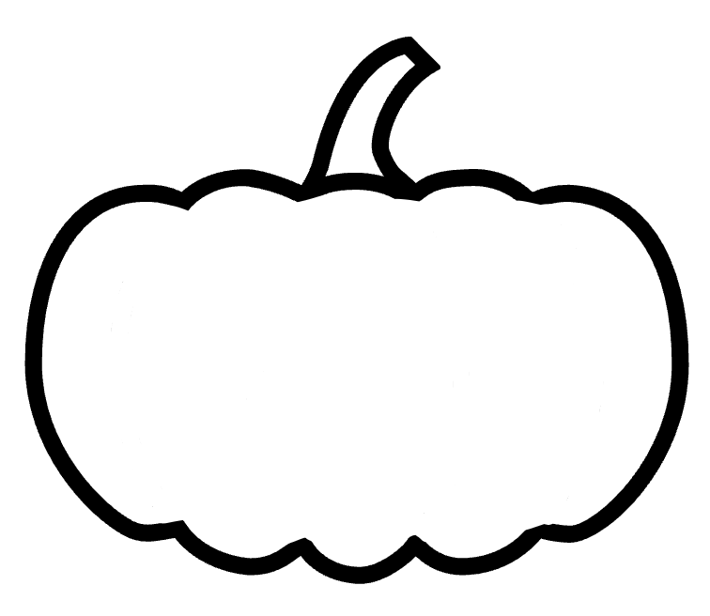
1. Pumpkins are an example of produce that relies heavily on pollinators. The video focuses on what conservation practice that helps pollinator populations?
2. One native pollinator that helps produce pumpkins is the:
Video
Video
1/4
2/4
A. Nutrient management
B. Habitat establishment or enhancement
C. Wetland establishment
D. Buffer strips
A. Leaf cutter bee
B. Pumpkin bee
C. Squash bee
D. Honey bee
3. Key components of pollinator habitat include all but:
4. When planning a pollinator habitat project to support pumpkin farming operations, what question(s) should you consider?
Video
Video
3/4
4/4
A. Diverse habitat with a lot of flowering plants
B. Consistent pesticide use
C. Areas of bare, open ground
D. Sunlight exposure on the ground
A. What is the cost of the project?
B. What management activities (ie: prescribed burns) do you plan to apply?
C. What is the target species?
D. All the above

Slide 7
Reading Station - Instructions
Each student in the group will read the article, Pumpkin Production Can Benefit From Conservation Practices by Susan V. Fisk, and answer the questions from the cards on the answer sheet in the “Reading” section.
Remember that answers will come directly from the reading passage.
Reading Station
- Day 1 -

Slide 8
Reading Station - Article
Print several copies of Pumpkin Production Can Benefit From Conservation Practices by Susan V. Fisk to include at station.

Slide 9
1. According to the article, what conservation practice(s) do vegetable growers in the Midwest not commonly use?
2. The study in the article supports that the conservation management used improved total soil aggregation. Soil aggregates are:
Reading
Reading
1/4
2/4
A. Reducing tillage
B. Using cover crops
C. Fertilizing
D. Both A and B
E. Both A and C
A. Silt particles
B. A type of fertilizer
C. Unrecognizable fossil pieces
D. Small particles of soil held together with a glue-like substance
3. This article focuses on these two conservation practices for a farming operations that grows pumpkins:
4. Write a summary statement of the article. The statement should be 2-3 complete sentences.
Reading
Reading
3/4
4/4
A. Using cover crops and reducing tillage
B. Reducing tillage and planting buffer strips
C. Reducing tillage and irrigating
D. Adding wind buffers and rotational grazing

Slide 10
Vocabulary Station - Instructions
Students in the group will work together to match the word cards with corresponding graphic or definition cards. (See Illinois Ag in the Classroom’s Pumpkin Ag Reader page 1.) Once the cards are paired, signal for the teacher to come and check the answers. Fill in definitions to vocabulary words on the answer sheet in the “Vocabulary” section.
Please shuffle cards before moving to the next station to reset the Vocabulary Station.
Vocab Station
- Day 1 -

Slide 11
Vocab Station – Pumpkin Ag reader
Print several copies of Pumpkin Ag Reader by National Agriculture in the Classroom, Illinois Agriculture in the Classroom, and The University of Arizona Cooperative Extension.

Slide 12
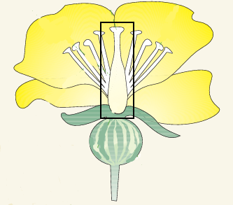
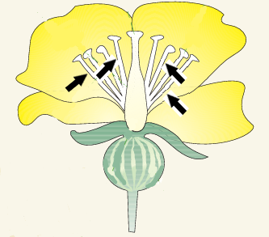
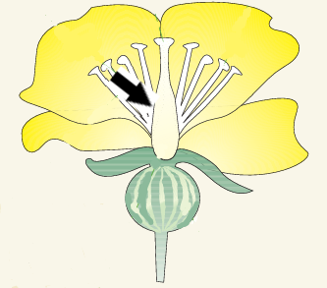
Pistil
Stamens
Stigma

Slide 13
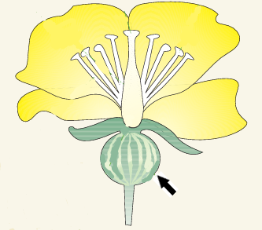
Pollen
Pumpkin
Ovules
Yellow powder
made by stamens
Tiny egg cells at the bottom of the pistil

Slide 14
Vine
Blossom
Pollination
Long flexible stems that trail or creep along the ground or climb by clinging to a support with tendrils or claspers
Transfer of pollen from the anther (from stamen of a male flower) to the stigma (from pistil of a female flower)
Flower of the plant that will turn into the pumpkin

Slide 15
Model Station - Instructions
Each student in the group will review the supporting materials and draw a simple sketch that illustrates an accurate model of a pumpkin plant and include labels for key structures in the “Model” section.
Model Station
- Day 2 -

Slide 16
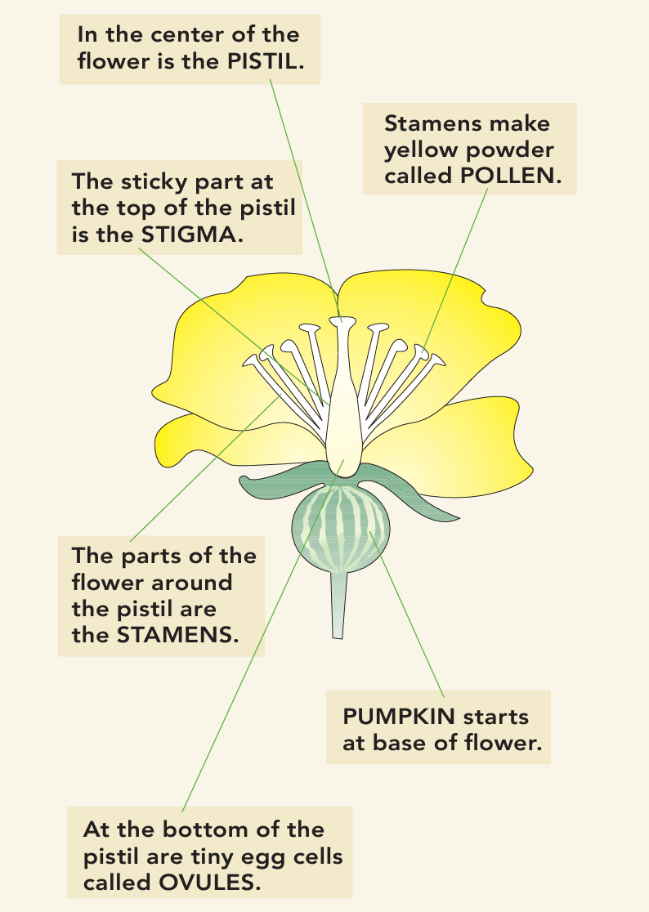
Model Station – Supporting Information
Refer to the graphic by Illinois Ag in the Classroom (right) and a time-lapse video by Seemingly Forever Timelapse(on YouTube) when drawing the model of a pumpkin plant.
Video full URL: https://youtu.be/yHaPDJCLCqM?si=yiWMKvePoUdgsqDU
After reviewing the materials, each student will draw an accurate model of a pumpkin plant. The drawing should include: vine, leaves, female flower, male flower, and pumpkin.
Graphic credit: Pumpkin Ag Reader by National Agriculture in the Classroom, Illinois Agriculture in the Classroom, and The University of Arizona Cooperative Extension

Slide 17
Comparison Station - Instructions
Each student in the group will watch the video, Male vs. Female Pumpkin Flower by Wild Floridian, and answer the questions from the cards on the answer sheet in the “Comparison” section.
Compare Station
- Day 2 -

Slide 18
Compare
Compare
1/3
2/3
1. How are the male and female flowers of pumpkins similar or different in terms of size?
2. How do the stems of male and female flowers of pumpkins compare?
Compare
Compare
3/3
- BONUS -
1. How is the timing of male and female flowers development and appearance similar or different?
For a pumpkin to grow, pollen must transfer from a male to a female pumpkin flower. What are the specific flower parts that the pollen transfers to and from?
(Hint: Both were featured at the Vocabulary station.)

Slide 19
Review Station - Instructions
The group will review their answer sheets and discuss what they’ve learned at previous stations for 3-5 minutes.
Each student will answer the prompt using information learned throughout the stations on the answer sheet in the “Review” section.
Review Station
- Day 2 -

Slide 20
Review Station - Prompt
Write a 3-5 sentence summary statement answering the question “What did you learn during the Conservation and Pumpkin stations?”
Your answer should include:
conservation practices utilized on pumpkin operations
components and functions of pumpkin plants’ flowers
a description of pollinators’ role in pumpkin growth and production.
Review Station
- Day 2 -

Slide 21
Conservation and Pumpkins Stations
Name: __________________________ Date: ____________________
Video
______________________________
______________________________
______________________________
______________________________
Vocabulary
Pistil - ____________________________________
___________________________________________
Stamens - _________________________________
___________________________________________
Stigma - __________________________________
___________________________________________
Pollen - ___________________________________
___________________________________________
Pumpkin -_________________________________
___________________________________________
Ovules - __________________________________
___________________________________________
Vine - ____________________________________
___________________________________________
Blossom - _________________________________
___________________________________________
Pollination - _______________________________
___________________________________________
Reading
_____________________________
_____________________________
_____________________________
_________________________________________________________________________________________________________________________________________________

Slide 22
Model
Review ______________________________________________________________________________________________________________________________________________________________________________________________________________________________________________________________________________________________________________________________________________________________________________________________________________________________________________________________________________________________________________________________
Comparison
________________________________________________________________________
________________________________________________________________________
________________________________________________________________________
Bonus. ________________________________ _______________________________________

Slide 23
Conservation and Pumpkins Stations
Name: __ANSWER KEY_____________ Date: ____________________
Vocabulary
Pistil - _center of the female flower_________ __________________________________________
Stamens - __parts of the flower around the_
pistil______________________________________
Stigma - _sticky part at the top of the pistil__
__________________________________________
Pollen - _ yellow powder created by the___
stamens__________________________________
Pumpkin -_fruit that starts at the base of the
female flower____________________________
Ovules - _tiny egg cells at the bottom of the pistil _____________________________________
Vine - _long flexible stems that trail or creep along the ground or climb by clinging to a support with tendrils or claspers____________
Blossom - _the flower of the plant that will
turn into the pumpkin_____________________
Pollination - _the transfer of pollen from the anther (from stamen of a male flower) to___ the stigma (from pistil of a female flower)___
Video
_B___________________________
_C___________________________
_B___________________________
_D___________________________
Reading
_D____________________________
_D____________________________
_A____________________________
Answers vary. Answer could include that using cover crops and reduced tillage or no till can decrease erosion, reduce runoff, improve wildlife habitat, etc., and is generally more beneficial compared to a conventional system.

Slide 24
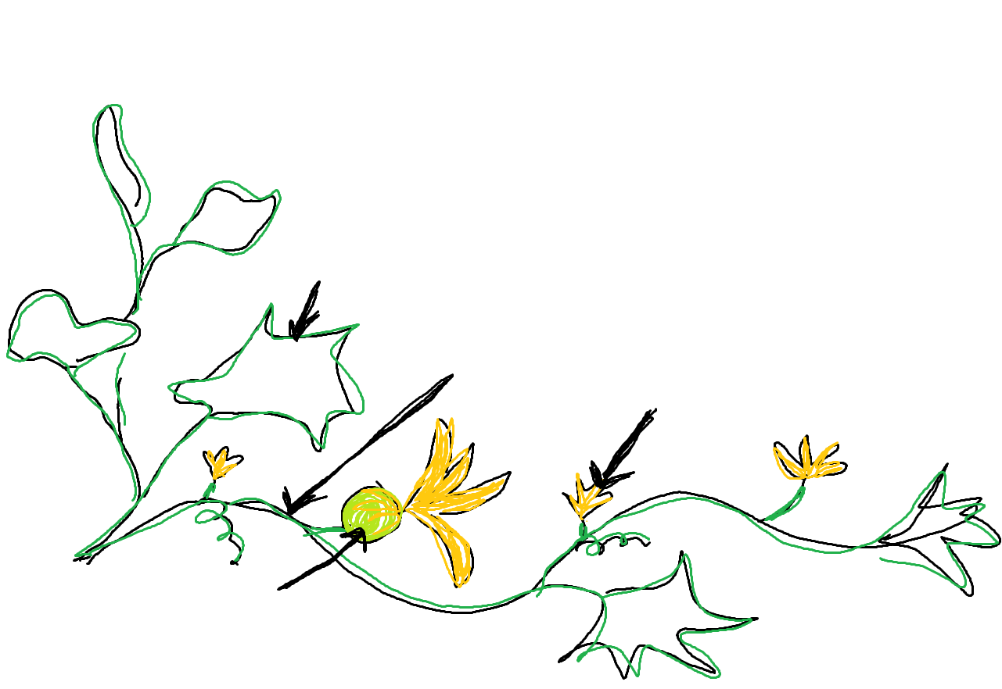
Model
Review _Answers vary._________
Answers could include:________
- Using cover crops, reducing tillage, and establishing or enhancing pollinator habitat are a few conservation practices that can be utilized on pumpkin operations.
- See vocabulary section for full list of flower components.
- Pollinators like squash bees are critical in the growth and production of pumpkins. A pumpkin develops at the base of a female flower after it is pollinated.
Answers vary but below is an example of a simple illustration.
Leaf
Vine
Male flower
Pumpkin
Female flower
Comparison
_male flowers are smaller______________
_male flowers – flower, stem___________
_female flowers – flower, fruit, stem_____
_male flowers show up first_____________
Bonus. __Male – anther, part of stamen___ _Female – stigma, part of pistil____________

Slide 25
Acknowledgements
Resources referenced are provided by Conservation Blueprint, Illinois Agriculture in the Classroom, National Agriculture in the Classroom, Seemingly Forever Timelapse, Susan V. Fisk, the University of Arizona Cooperative Extension, and Wild Floridian. Station format is modeled after Kesler Science Station Labs.

